Slide 1

ED Dashboard
Background: A centralized ED dashboard that enables providers and staff to view the department as a whole, with key operational metrics.
Stakeholders: Physician-in-Chief; ED and HBS Department Chiefs; Department Directors and Managers; Chief Administrative Officer; and Associate Chief Administrative Officers.
BI Tool Used: Tableau

Slide 2
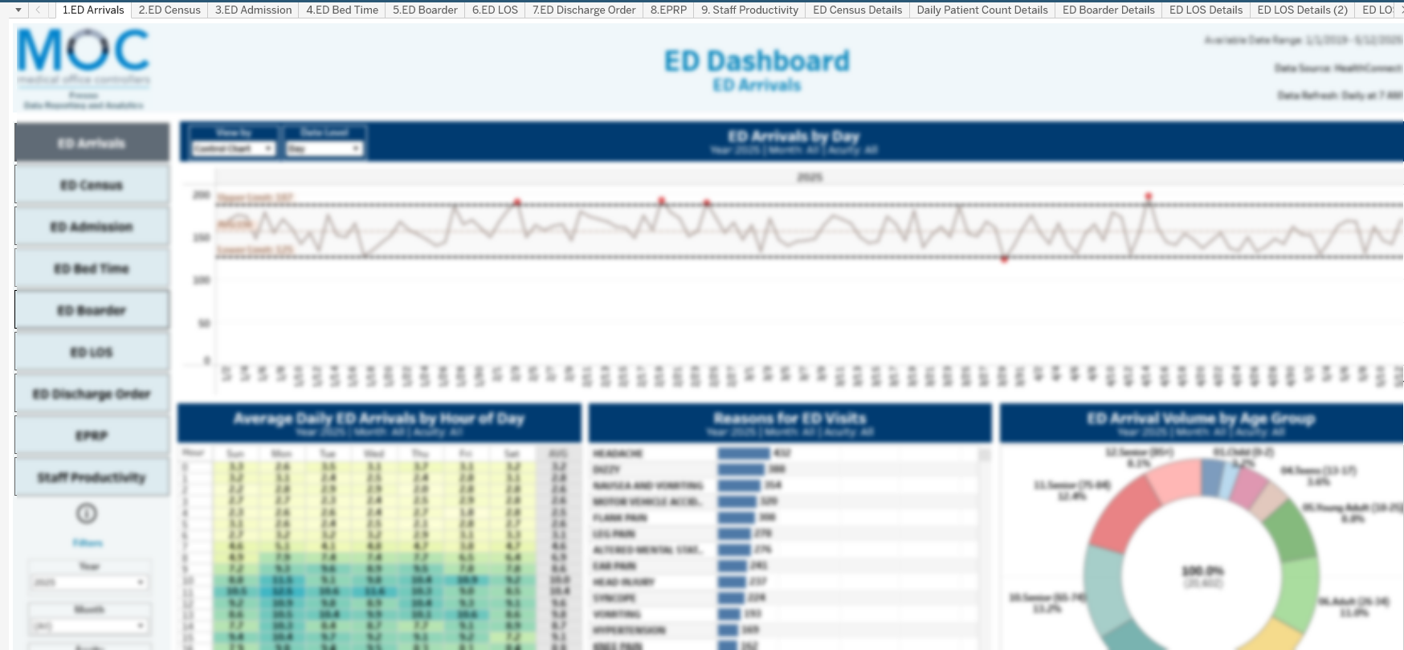

Slide 3
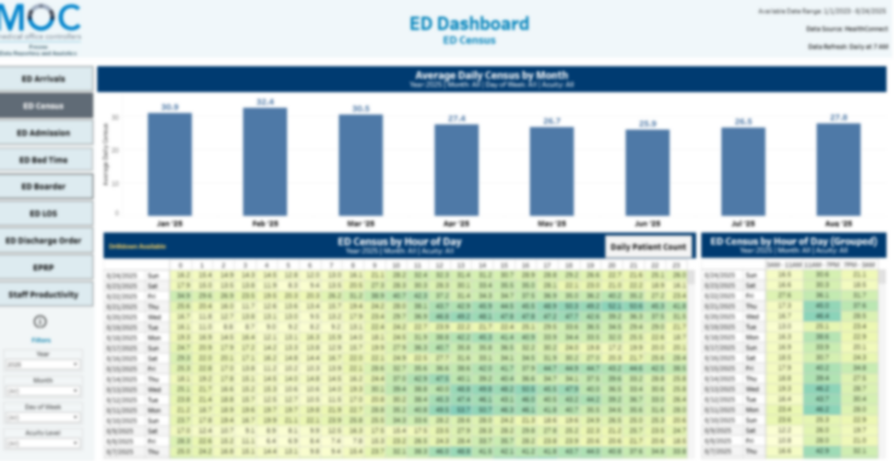

Slide 4
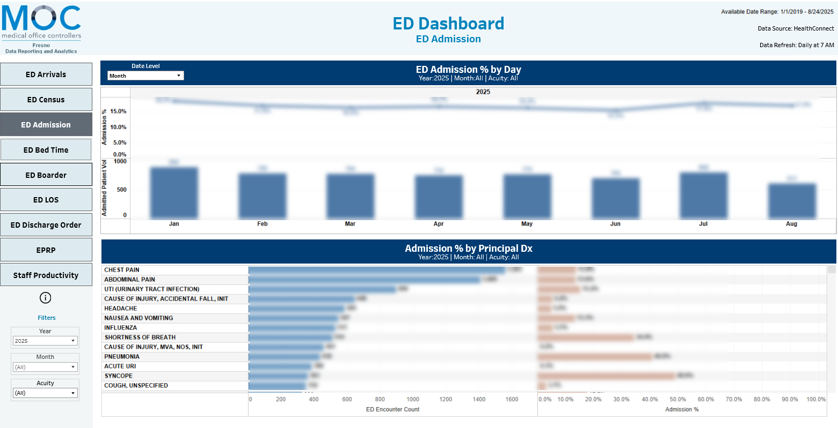

Slide 5
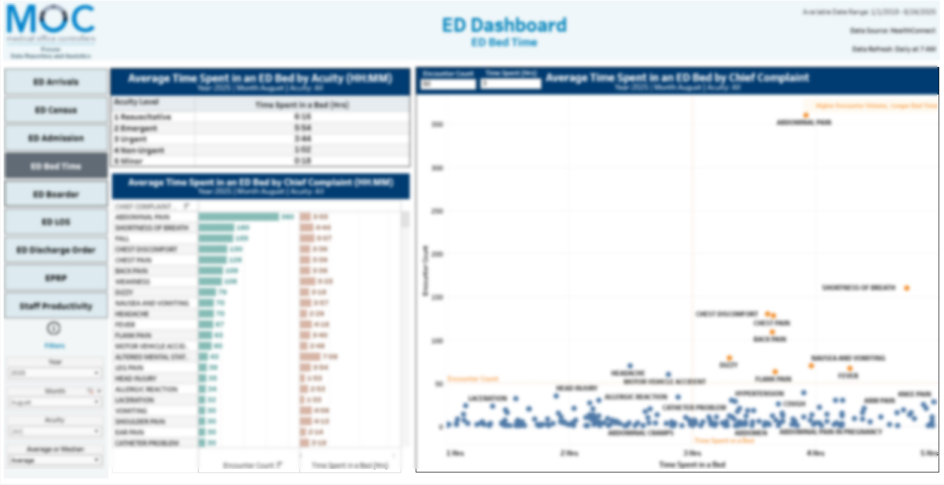

Slide 6
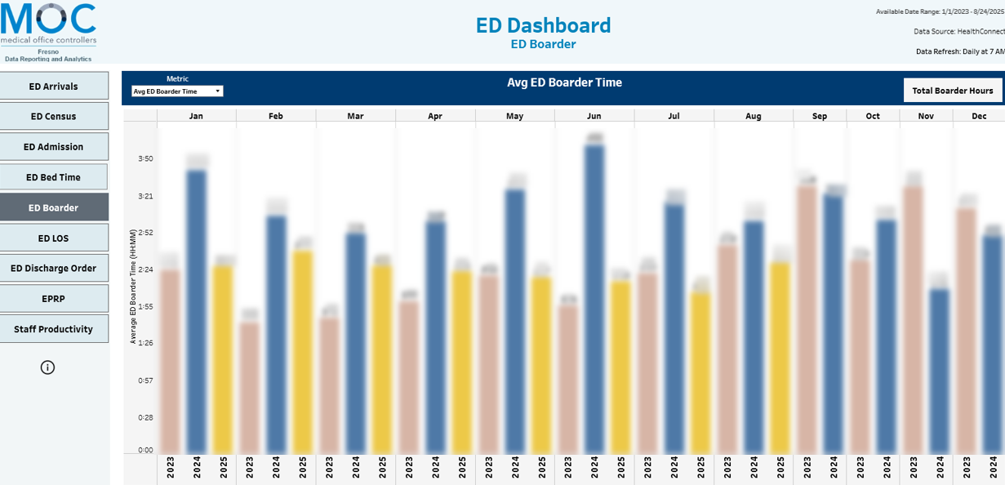

Slide 7
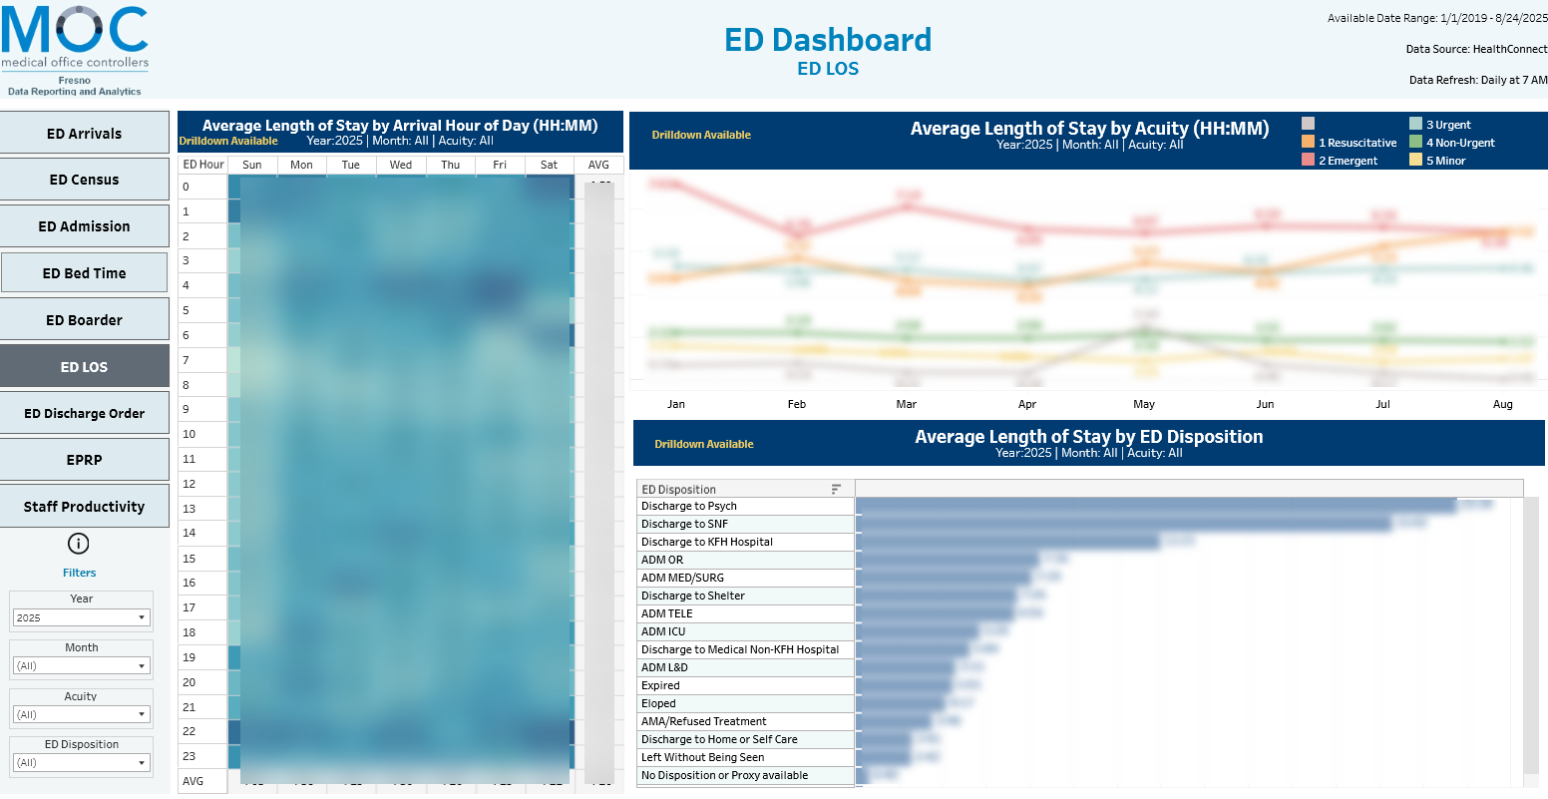

Slide 8
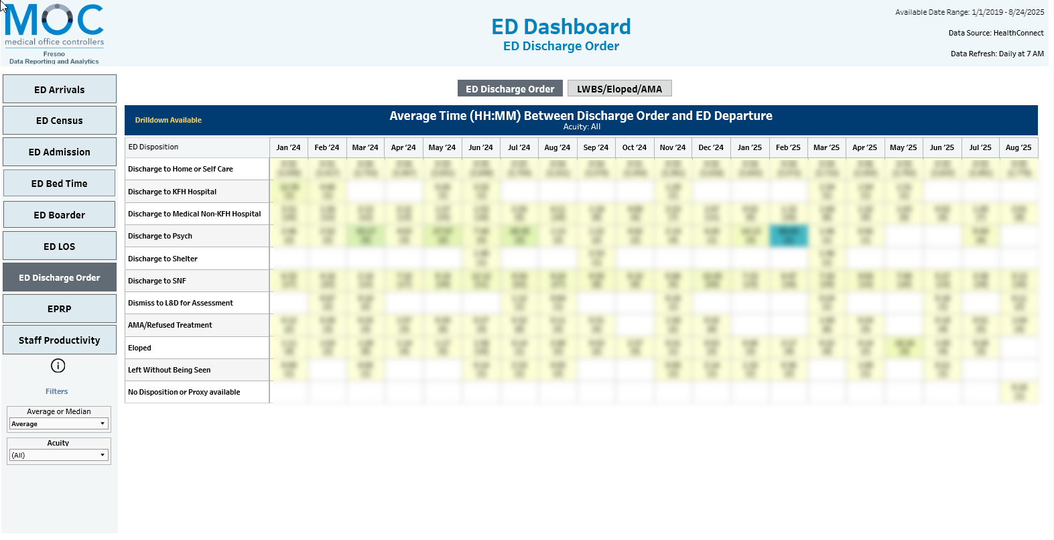

Slide 9
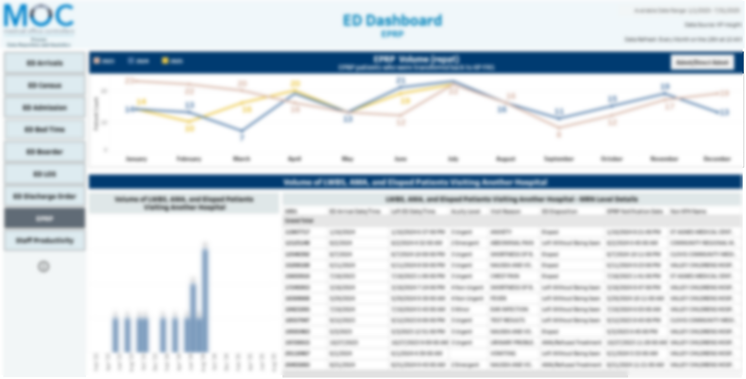

Slide 10
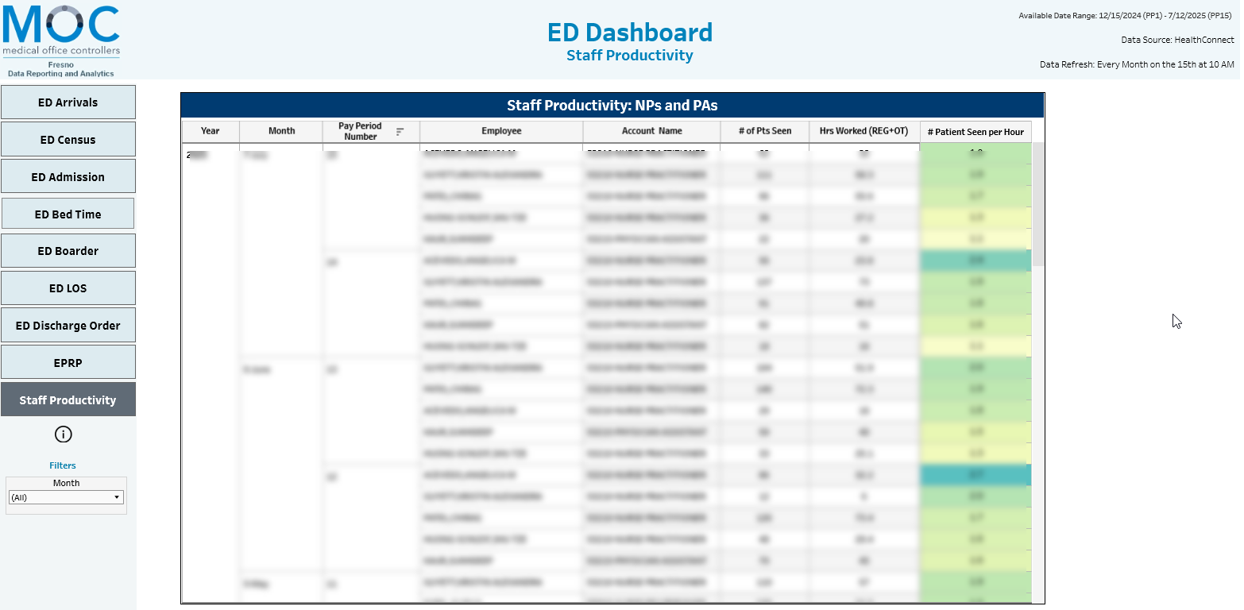

Slide 11
PCP Quality Performance Dashboard
Background: A centralized quality performance dashboard to monitor PCP performance and support patient outreach efforts to meet quality goals.
Stakeholders: Physician-in-Chief; AFM Department Chief; Department Directors and Managers; Chief Administrative Officer; and Associate Chief Administrative Officers.
BI Tool Used: Tableau

Slide 12
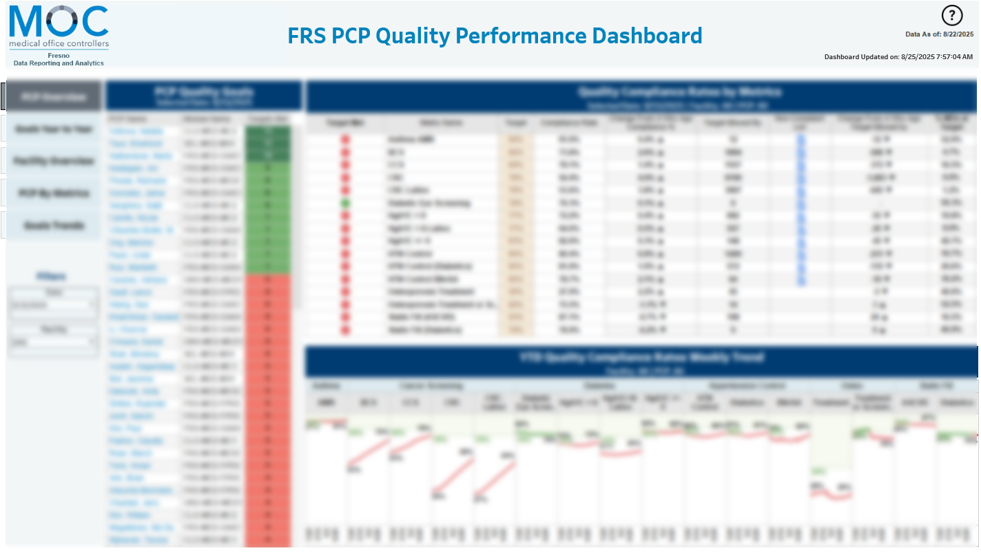

Slide 13
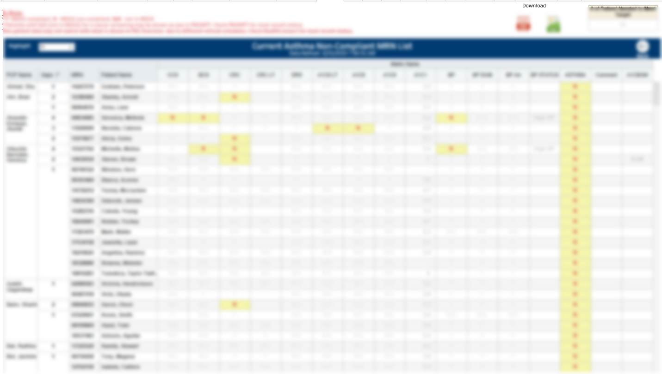

Slide 14
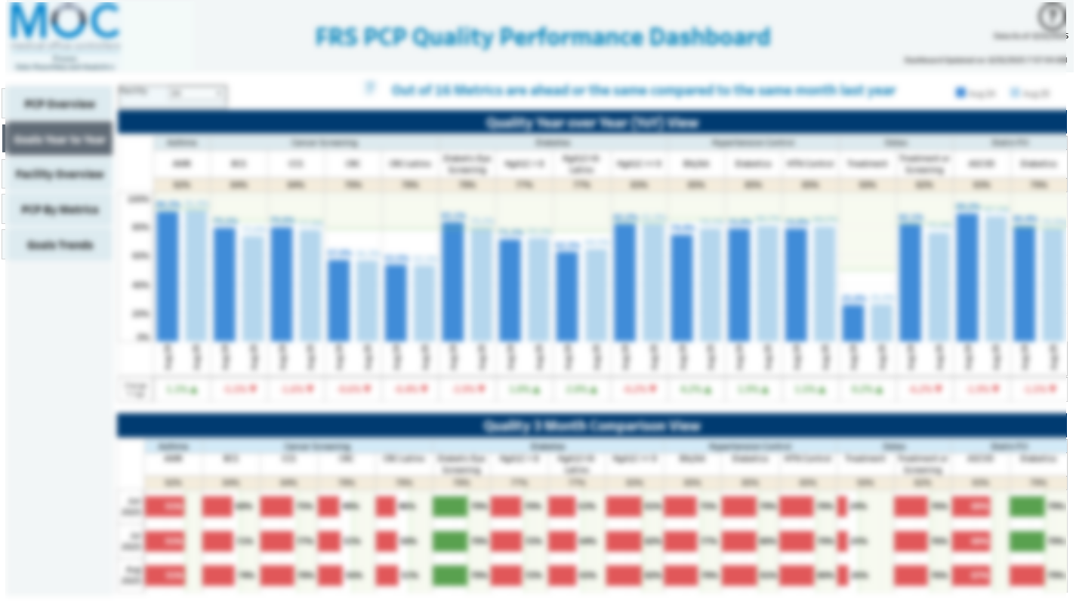

Slide 15
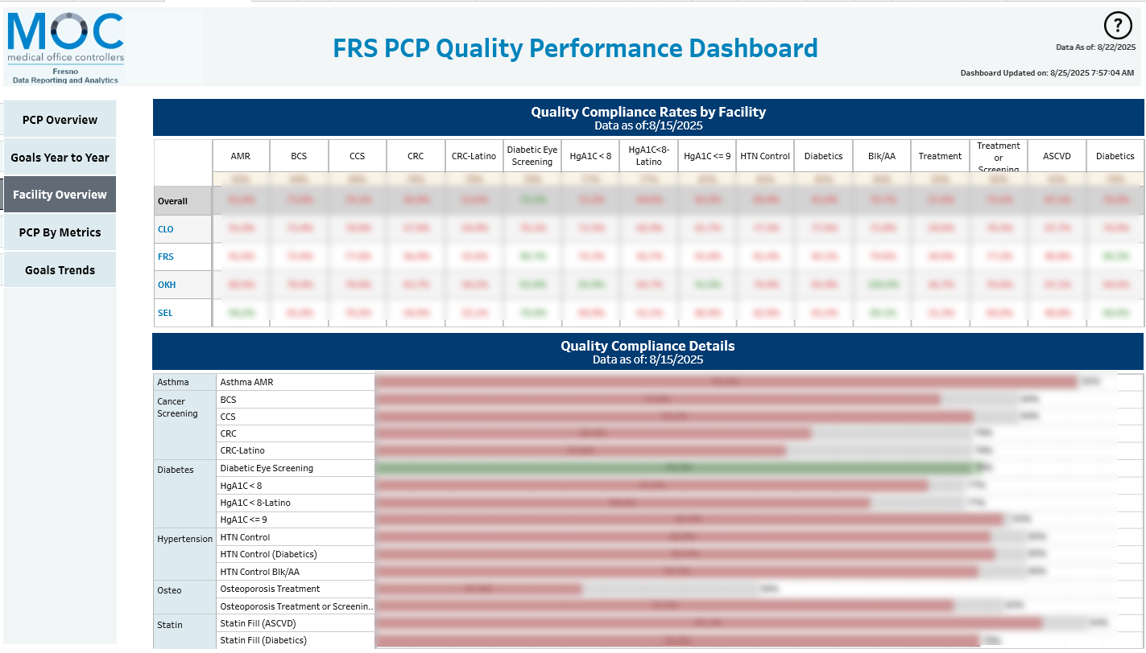

Slide 16
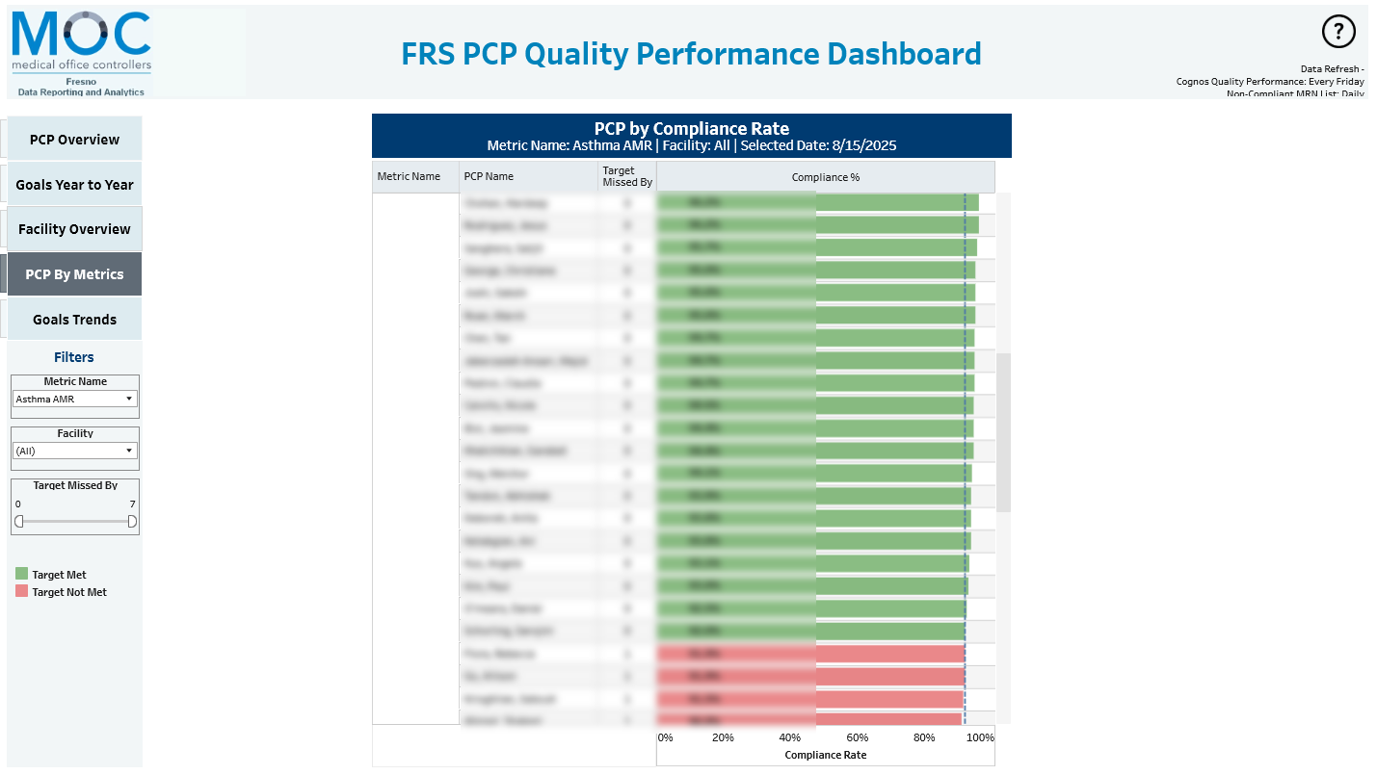

Slide 17
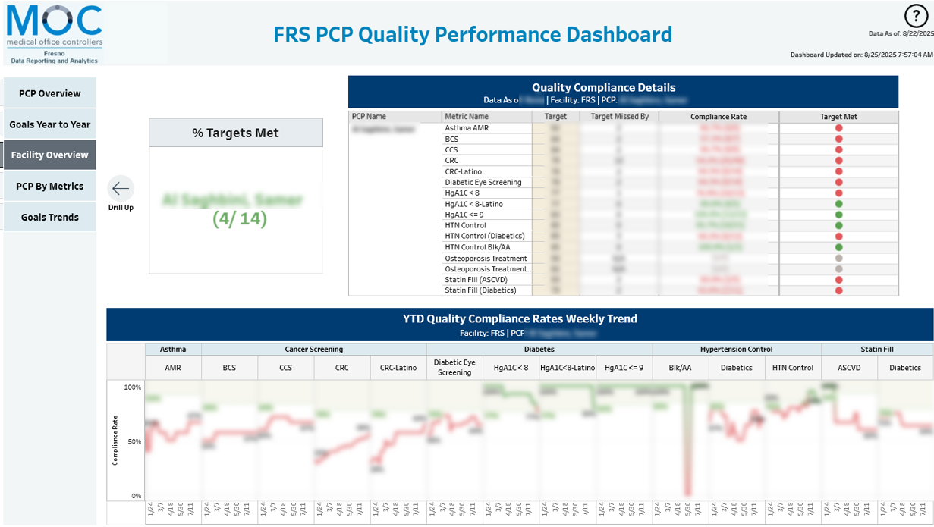

Slide 18
CareXM Mental Health Trainee Dashboard
Background: A Mental Health Trainee Care Experience dashboard that enables hospital leadership to monitor performance and use the results for coaching purposes.
Stakeholders: Regional Leadership Team for Mental Health
BI Tool Used: Tableau

Slide 19
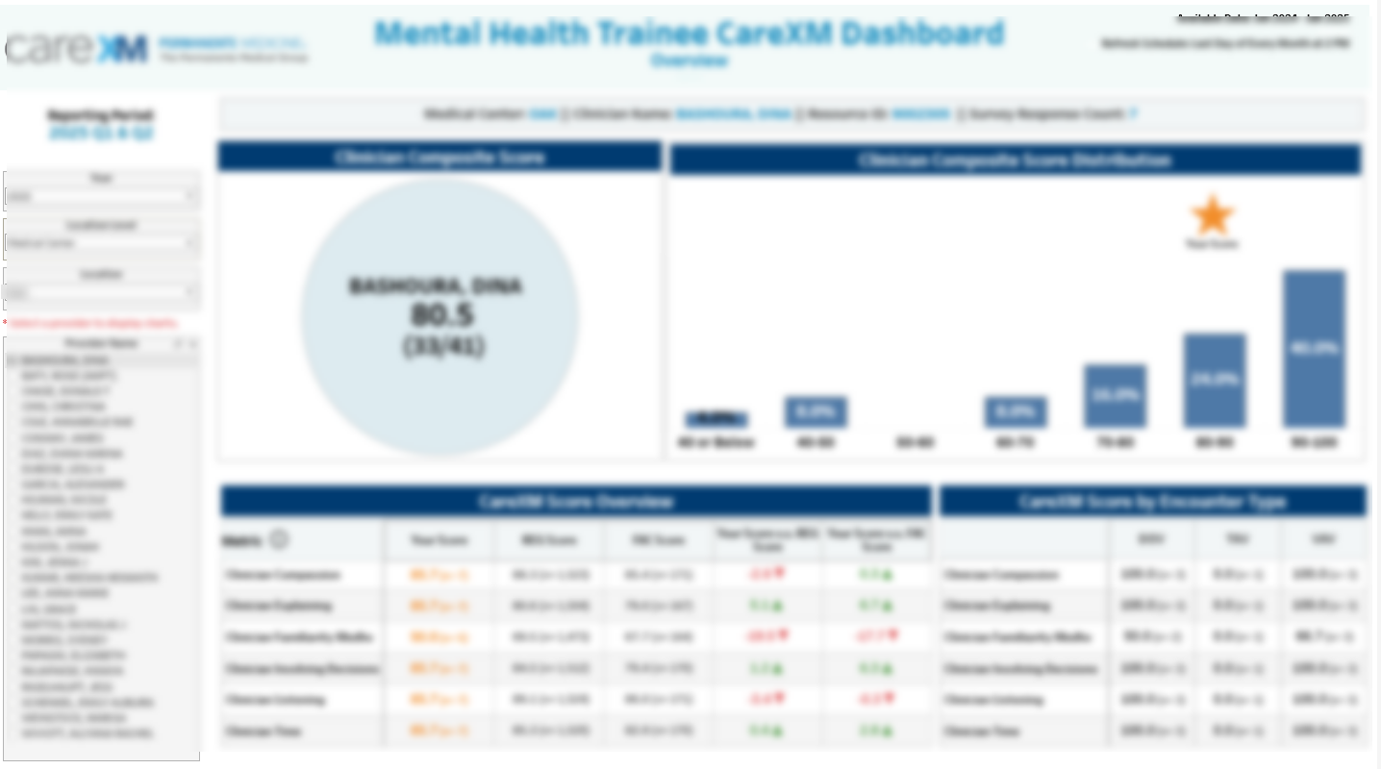

Slide 20
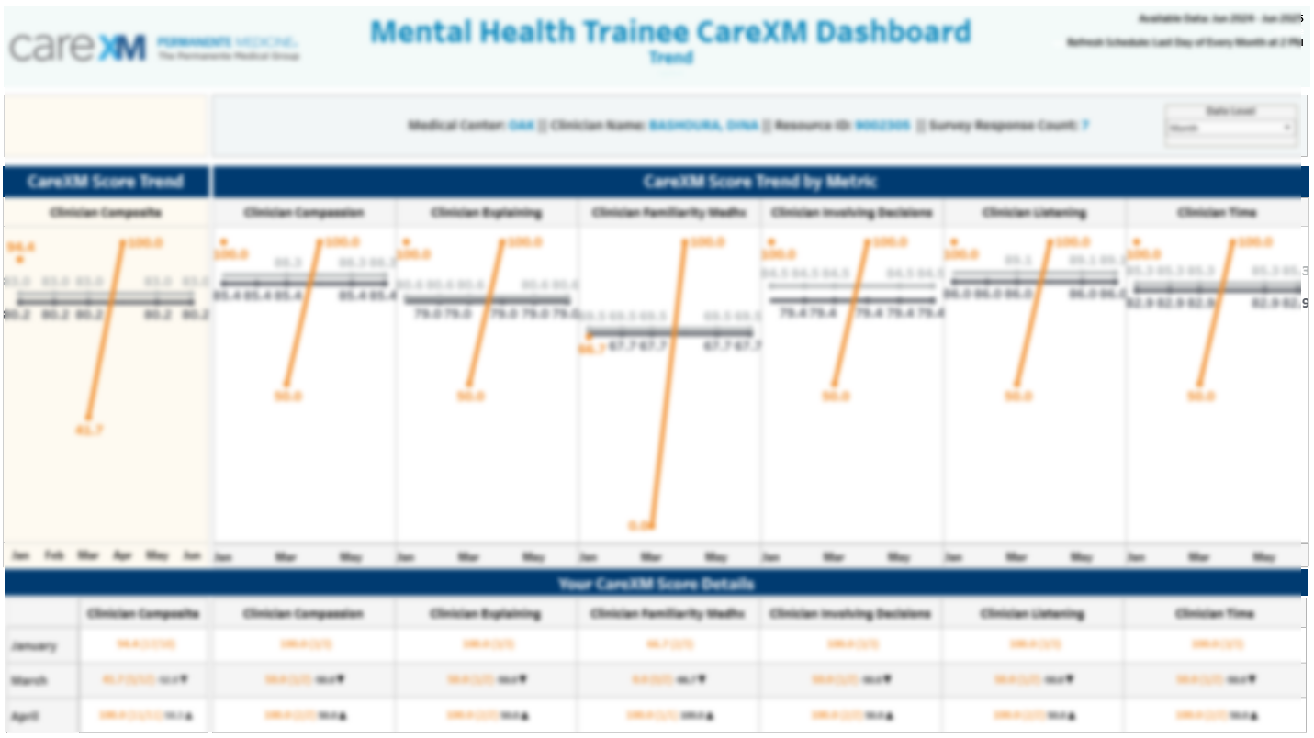

Slide 21
